Slide 1

Chapter 6 Registers and Counters
6-1
Registers
6-2
Shift Registers
6-3
Ripple Counters
6-4
Synchronous Counters
6-5
Other Counters
6-6
HDL for Registers and Counters
2

Slide 2
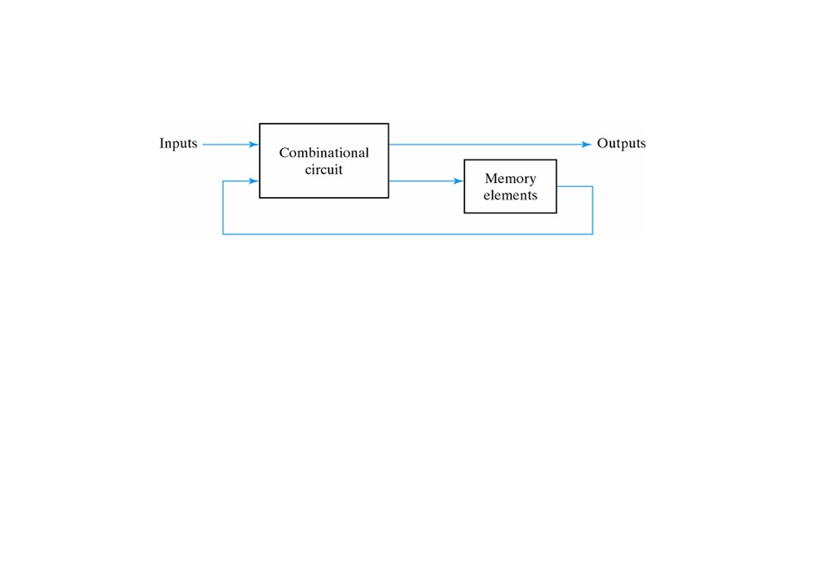
6-1 Registers
• Clocked sequential circuit
- No flip-flops / no feedbacks → reduce to combinational circuit
- No combinational circuit → remain a sequential circuit
• registers and counters
• Register: a group of flip-flops capable of storing one bit of information
- n-bit register consists of a group of n flip-flops capable of storing n bits
• Counter: a register going through a predetermined sequence of states
3

Slide 3
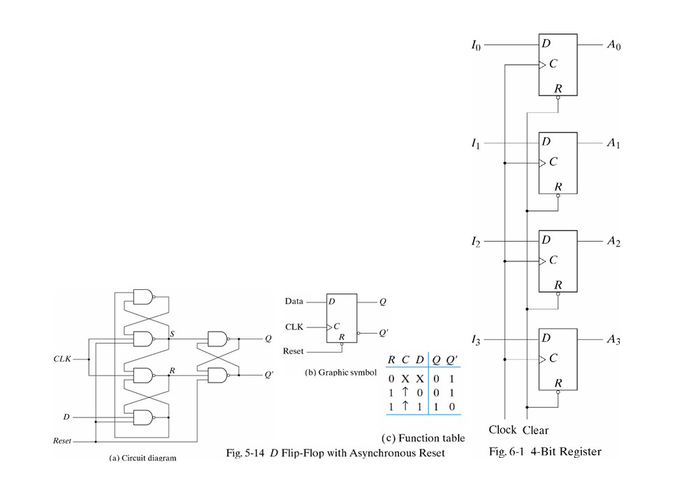
4-bit Register
delay – flip-flop 위치에 따라 delay가 다르다. (미소해서 보통 동시에 처리된다고 가정)
next clock 기준 – 위치에 따른 delay 차이로 인해 현재 clock을 기준으로 값을 변경하면 동시에 변경이 안될 수도 있다. (가까운 것은 현재 clock, 먼 것은 다음 clock)
• Simplest register: consisting of only flip-flops without any gates
• Example 6-1: 4-bit register
- positive edge trigger
- When the clear input goes to 0, all flip- flops are reset
- The R inputs must be maintained at
logic 1 during normal clocked operation
4

Slide 4
Register with Parallel Load
Parallel load
• loading: the transfer of new information into a register
• parallel loading: all the bits of the register are loaded simultaneously with a common clock pulse
- Load control: determine when to load new information Approaches to register with parallel load
1.controlling the clock input signal with an enabling gate:
inserting gates into the clock path is ill advised because it means that logic is performed with clock pulses. The insertion of logic gates produces uneven propagation delays between the master clock and the inputs of flip‐flops.
To fully synchronize the system, we must ensure that all clock pulses arrive at the same time anywhere in the system, so that all flip‐flops trigger simultaneously
2.controlling the D inputs (better): ensure that all clock pulses arrive at the same time anywhere in the system
5

Slide 5
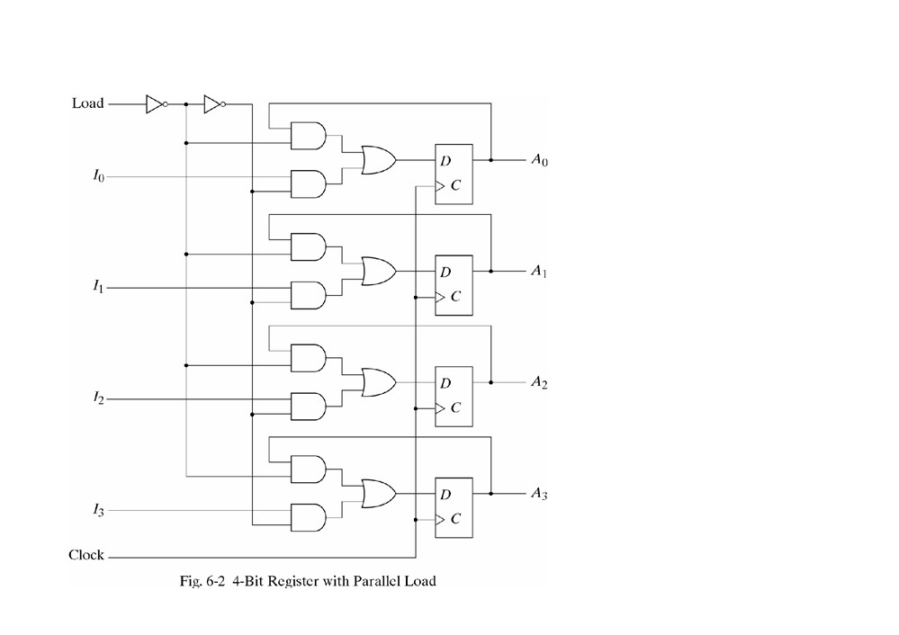
4-bit register with a load control input
load=1
• data are transferred into the register with the next positive edge of the lock
load=0
• outputs are connected to their respective inputs
•The feedback connection is necessary because the D flip-flop does not have a “no change” condition
•The clock pulses are
applied to the C inputs at all times
datapath serial mode – when information is transferred and manipulated one bit at a time
장점 : fewer hardware component 단점 : slow
datapath parallel mode – all the bits of the register are transferred at the same time
6

Slide 6
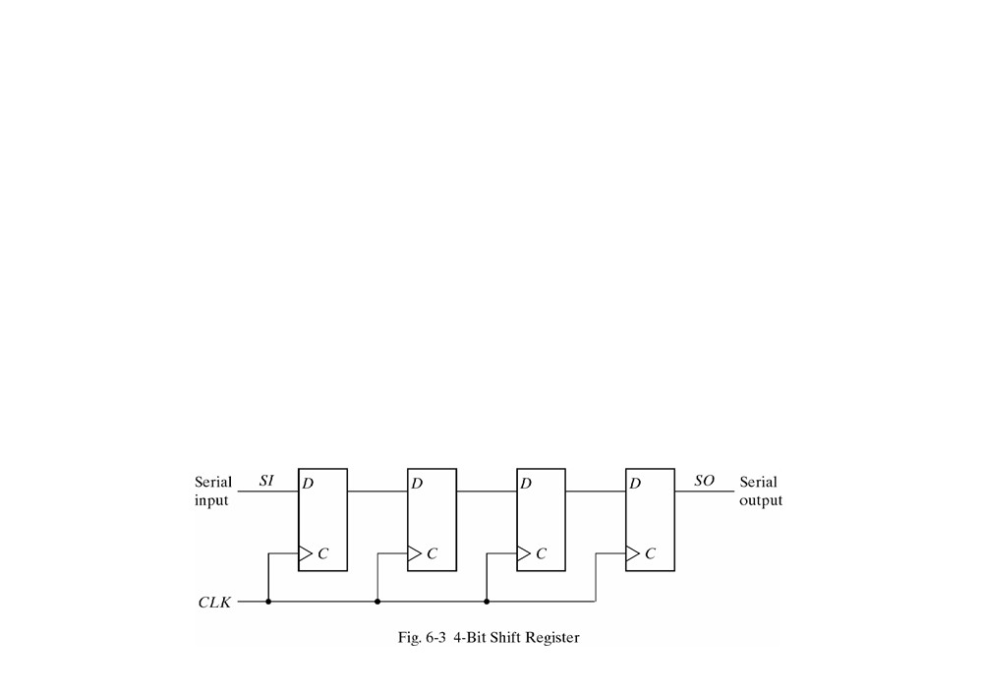
6-2 Shift Registers
• shift register: a register capable of shifting its binary information in one or both directions
• Example Fig. 6-3: each clock pulse shifts the contents of the register one bit position to the right
- serial input: determines what goes into the leftmost flip-flop
- serial output: taken from the output of the rightmost flip-flop
• Shift control: make the shift occur only with certain pulses
- inhibiting the clock (do not use to more synchronize your system
- control through the D inputs (shown later)
7

Slide 7
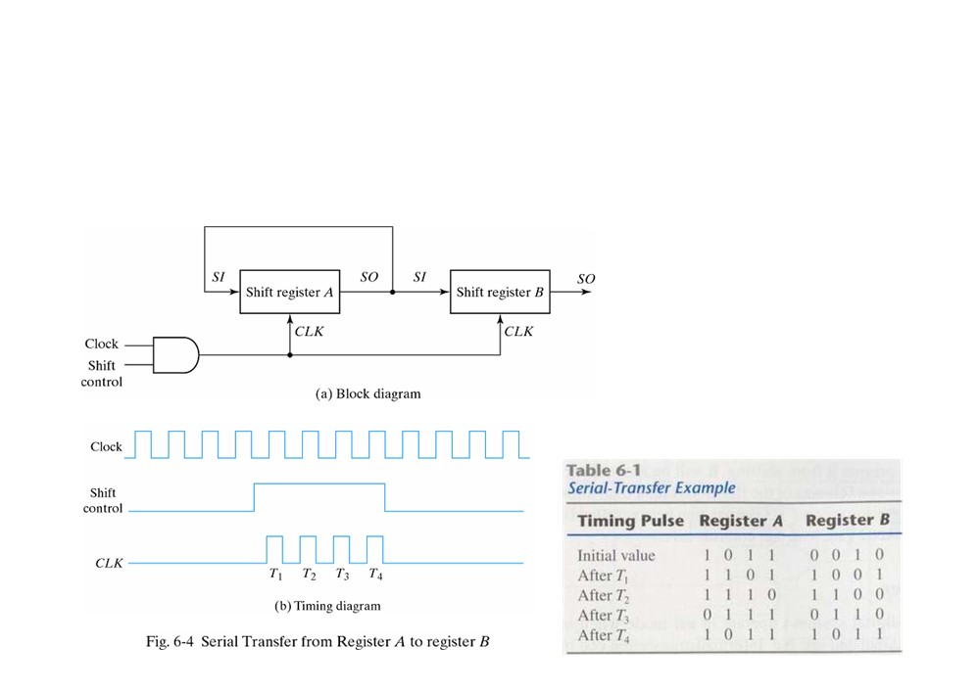
Serial Transfer
serial transfer: information is transferred one bit at a time by shifting the bits out of source register into destination register
• The serial output (SO) of
register A is connected to the serial input (SI) of register B and the SI of register A itself
• The shift control input determines when and how many times the registers are shifted
• serial vs. parallel
8

Slide 8
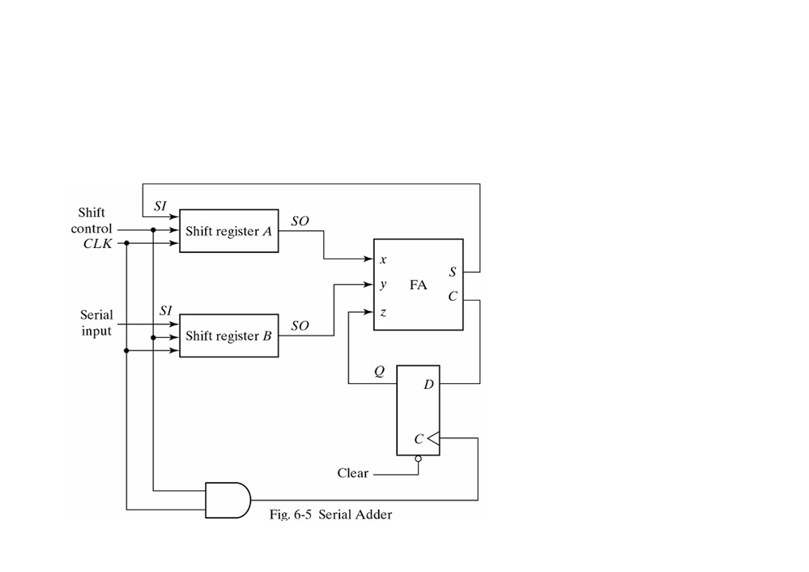
Serial Addition
Register A holds the augend + sum and register B holds the addend
- Initially, register A holds the augend, register B holds the addend and carry flip-flop are cleared to 0
All the numbers are transferred serially into B and added to A
•parallel adder: use
registers with parallel load
- # of full adders = # of bits
- faster
- combinational circuit
•serial adder: use shift registers
- requiring less equipment
- only one full adder
- sequential circuit
by shifting the sum into A while the
bits of A are shifted out, it is possible
to use one register for storing both
the augend and the sum bits.
(원래는 sum 저장하는 register 필요하다.)
9

Slide 9
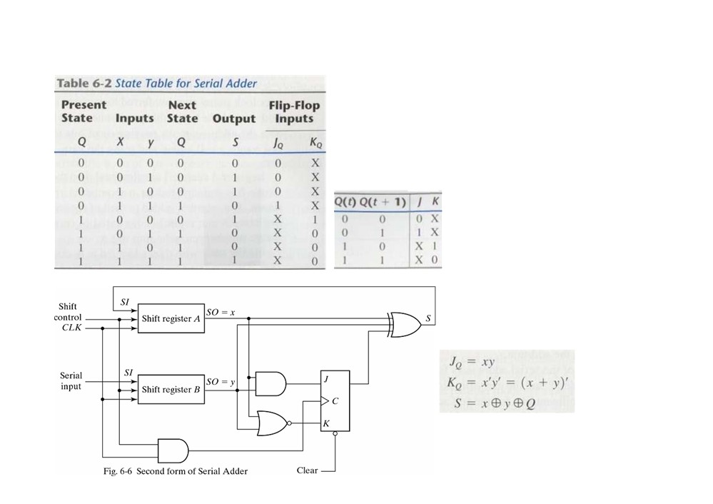
Second Form of Serial Adder
Design a serial adder using a JK FF
•Assume 2 shift registers as input
•Obtain state table with FF input/outputs
•Obtain input and output equations
•Draw the circuit
no full-adder
10

Slide 10
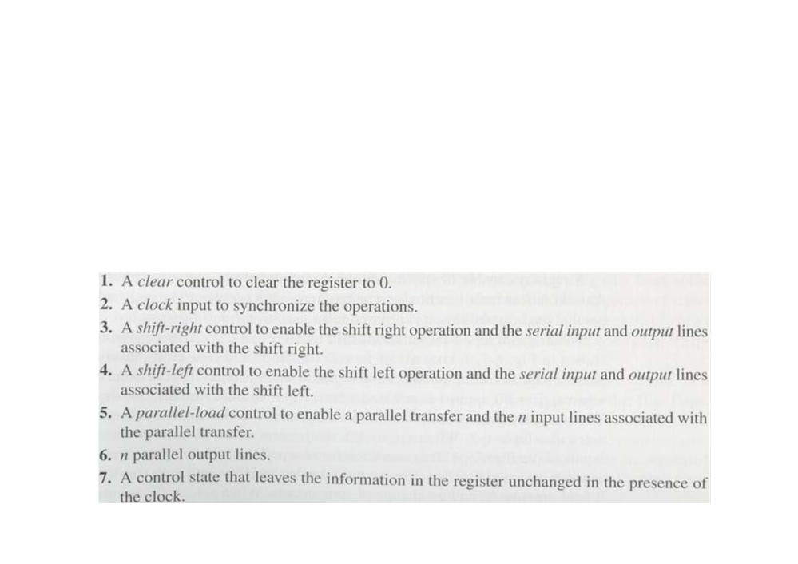
Universal Shift Register
• Unidirectional shift register: capable of shifting in one direction only
• Bidirectional shift register: capable of shifting in both directions
• universal shift register: has both shifts and parallel load capabilities
• The most general shift register has the following capabilities:
11

Slide 11
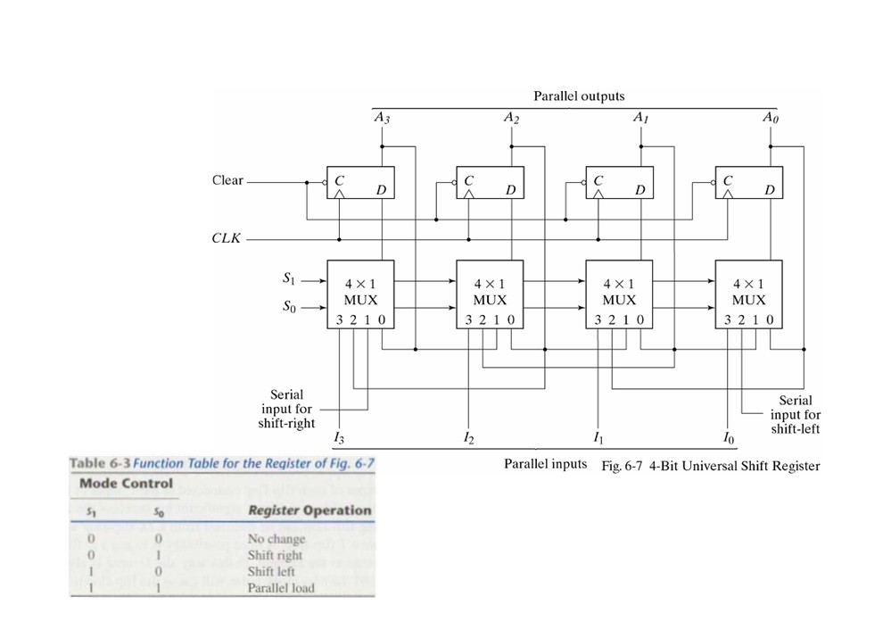
4-bit Universal Shift Register
Has all the
capabilities listed above
Selection inputs control the mode of operation
Shift registers are often used to interface
Ai
digital systems situated remotely from each other
Ai+1 Ai-1 Ii
12

Slide 12

6-3 Ripple Counters
• counter: a register that goes through a prescribed sequence of states upon the application of input pulses
- may occur at a fixed interval of time or at random
- may follow the binary number sequence or any other sequence of states
- n-bit binary counter: n flip-flops counting in binary from 0~2^{n}-1
• Two categories
- Ripple counters: FF output transition serves as a source for triggering other via the clock pin
• Binary ripple counter
• BCD ripple counter
- Synchronous counters: inputs of all FF receive the common clock
• discussed in Sections 6-4 and 6-5
13

Slide 13
Figure 6-8 4-Bit Binary Ripple Counter
14

Slide 14
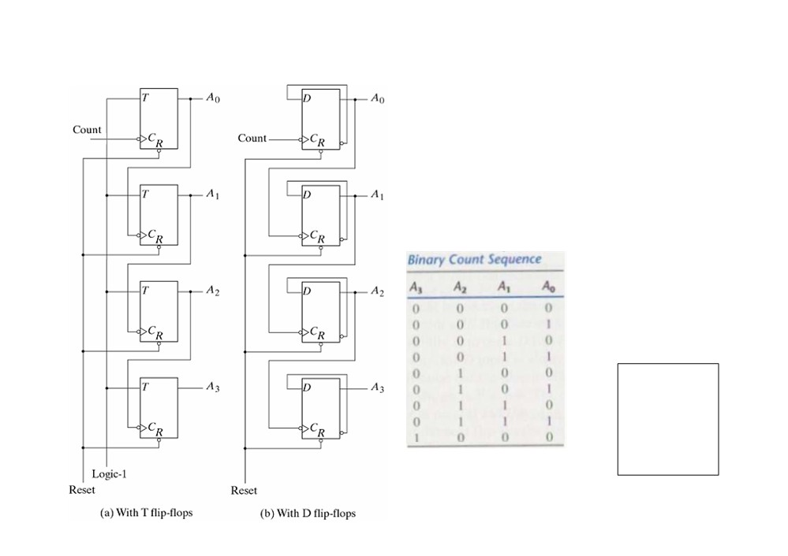
Figure 6-8 4-Bit Binary Ripple Counter
•One single count input
•Output of each FF connected to C input of next higher-order FF
•Three approaches
- from T
- from JK: J and K inputs tied together
- from D: complement output connected to the D input
Every time Ai goes from 1 to 0, it
complements Ai+1 (Negative trigger)
A3 A2 A1 A0
1 1 1 1
1 1 1 0
1 1 0 1
1 1 0 0
1 0 1 1
1 0 1 0
Binary count-down counter
1 0 0 1
1 0 0 0
• use positive-trigger T flip-flops instead
0 1 1 1
the flip-flops change one at a time in succession, and the signal propagates through the counter in a ripple fashion from on stage to the next
15

Slide 15
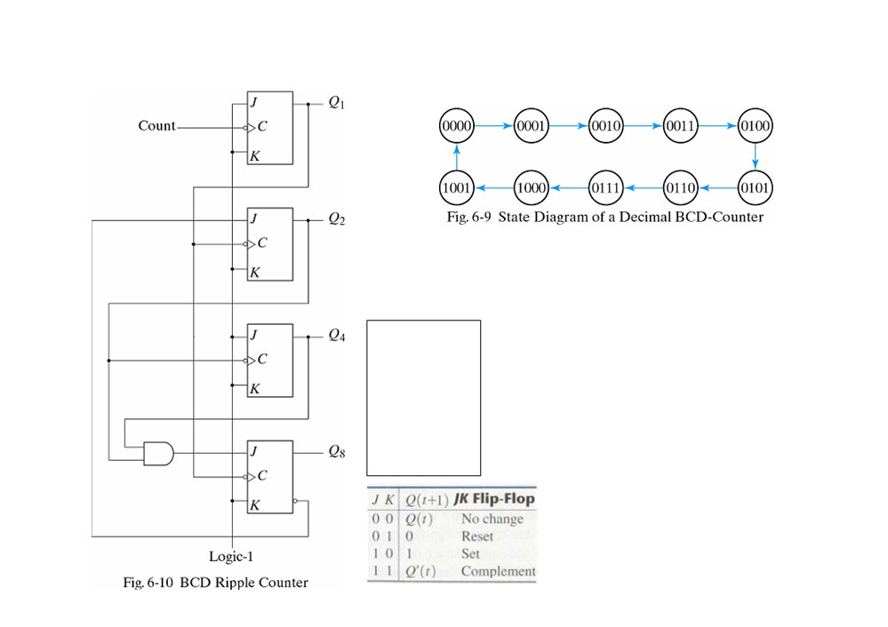
BCD Ripple Counter
• Decade decimal counter: 0 ~ 9
• Need at least 4 flip-flops, similar to a binary counter, but state after 1001 is 0000
Q8 Q4 Q2 Q1
Q1: count input
Q2: Q1 negative-edge and Q8 = 0 (complement)
Q1 negative-edge and Q8 = 1 (reset) Q4: Q2 negative-edge
Q8: Q1 negative-edge and Q2=Q4 =1 (complement)
Q1 negative-edge and Q2,Q4 others (reset)
0 0 0 0
0 0 0 1
0 0 1 0
0 0 1 1
0 1 0 0
0 1 0 1
0 1 1 0
0 1 1 1
1 0 0 0
1 0 0 1 0 0 0 0
15

Slide 16
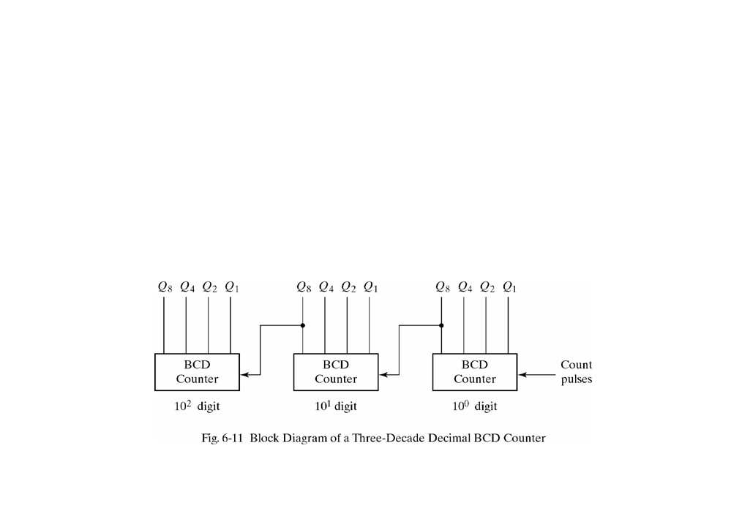
Three-Decade Decimal BCD Counter
•n-decade counter: count from 0 to 10n-1
•Input to nth decades come from Q8 of the previous (n-1)th decade
•When Q8 in one decade goes from 1 to 0, it triggers the count
for the next higher-order decade while its own decade goes from
9 to 0
16

Slide 17
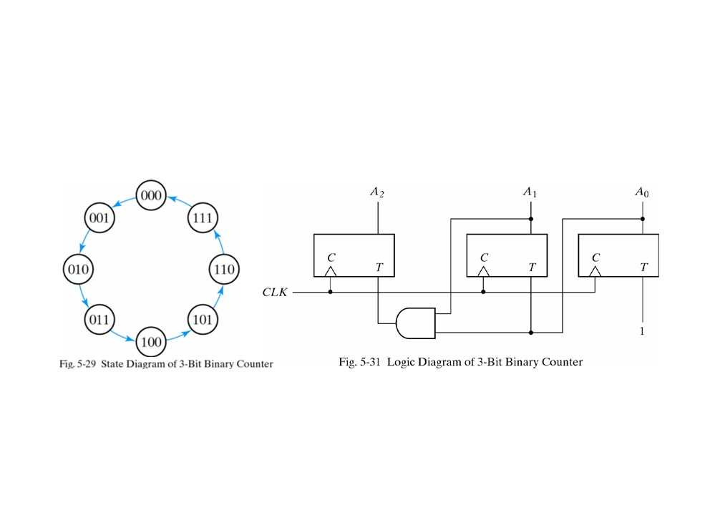
6-4 Synchronous Counters
• synchronous counter: clock pulses are applied to inputs of all FF
• 3-bit binary counter with T flip-flops
TA2=A1A0
TA1=A0
TA0=1
17

Slide 18
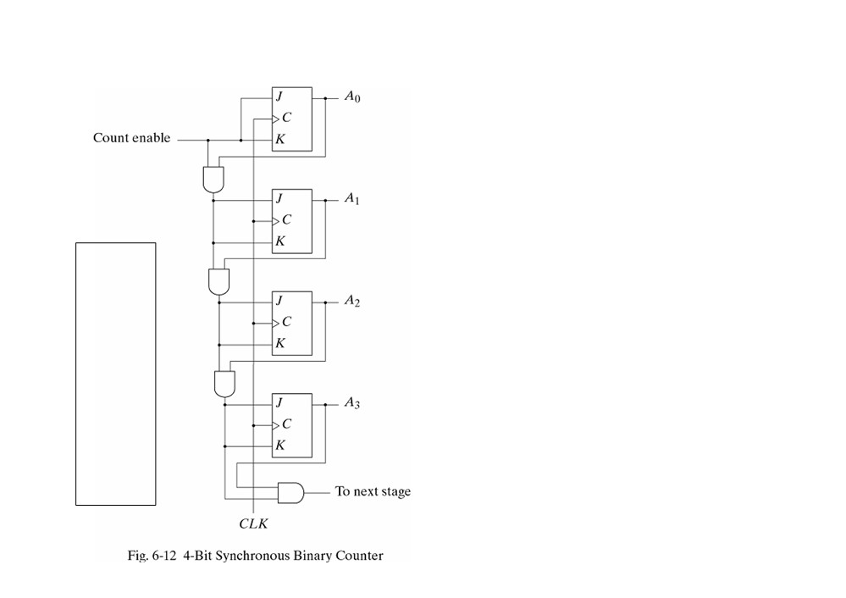

4-Bit Synchronous Binary Counter
• least significant position: complemented
with every pulse
• any other positions: complemented if all lower significant bits are equal to 1
• It can be extended to any number of stages, with each stage having an
addition FF and an AND gate that gives the output of 1 if all previous FF outputs are 1
• It can be triggered with either the positive or the negative clock edge
• It can be either of the JK-type, the T-
type, or the D-type with XOR gates
18

Slide 19
Figure 6-12 4-Bit Synchronous Binary Counter
16

Slide 20
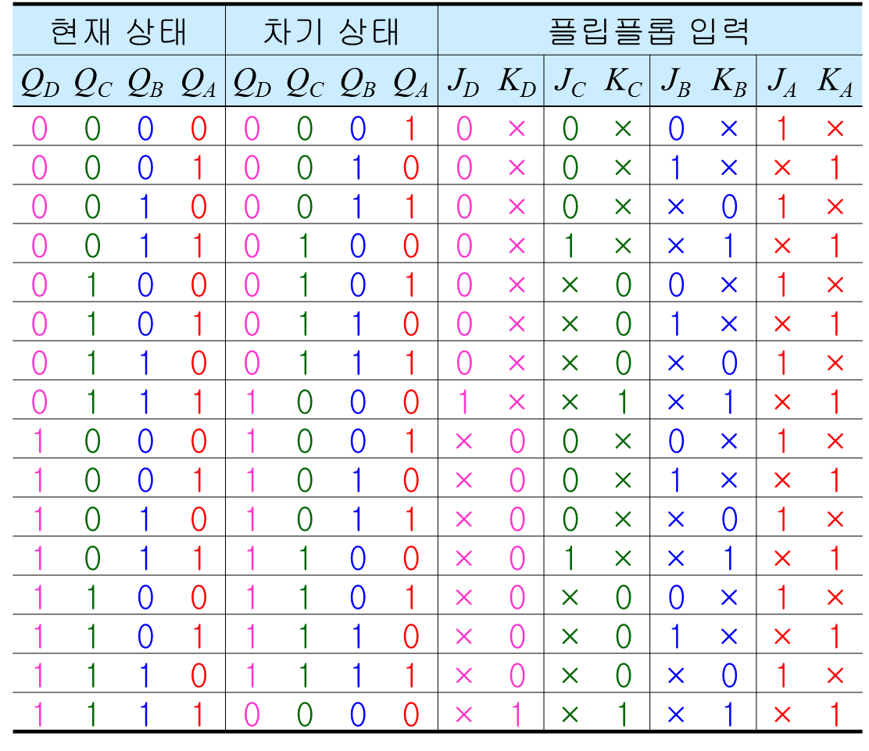
Figure 6-12 4-Bit Synchronous Binary Counter
17

Slide 21
Figure 6-12 4-Bit Synchronous Binary Counter
17

Slide 22
Figure 6-12 4-Bit Synchronous Binary Counter
17

Slide 23
Figure 6-12 4-Bit Synchronous Binary Counter
17

Slide 24
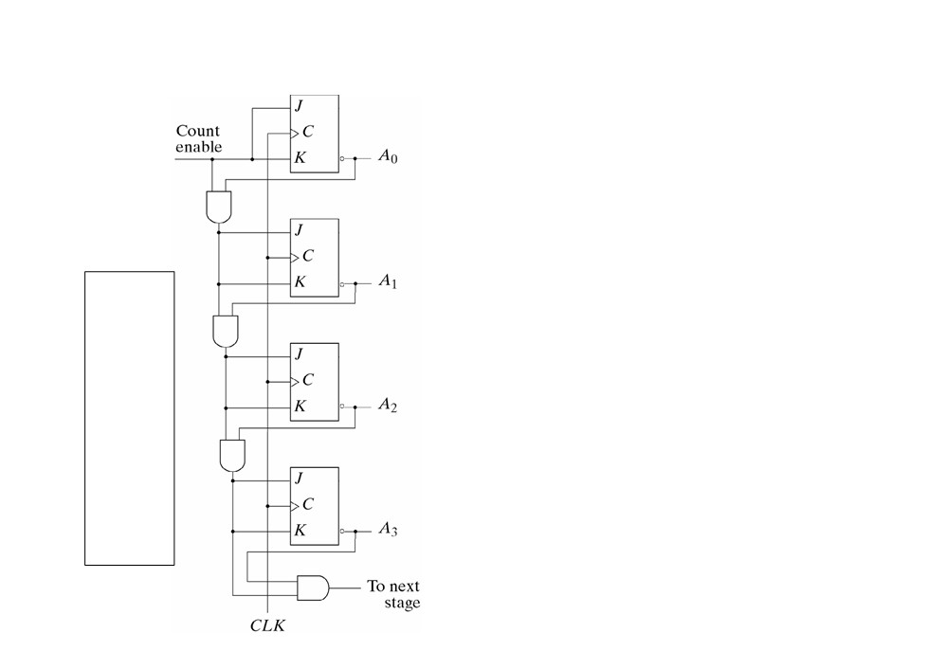
Synchronous Count Down Binary Counter
• similar to 4-Bit synchronous count up
binary counter
A3 A2 A1 A0
• least significant position: complemented with every pulse
1 1 1 1 1 1 1 0 1 1 0 1 1 1 0 0 1 0 1 1 1 0 1 0 1 0 0 1 1 0 0 0 0 1 1 1 0 1 1 0 0 1 0 1 0 1 0 0 0 0 1 1 0 0 1 0 0 0 0 1 0 0 0 0
• any other positions: complemented if all lower significant bits are equal to 0
19

Slide 25
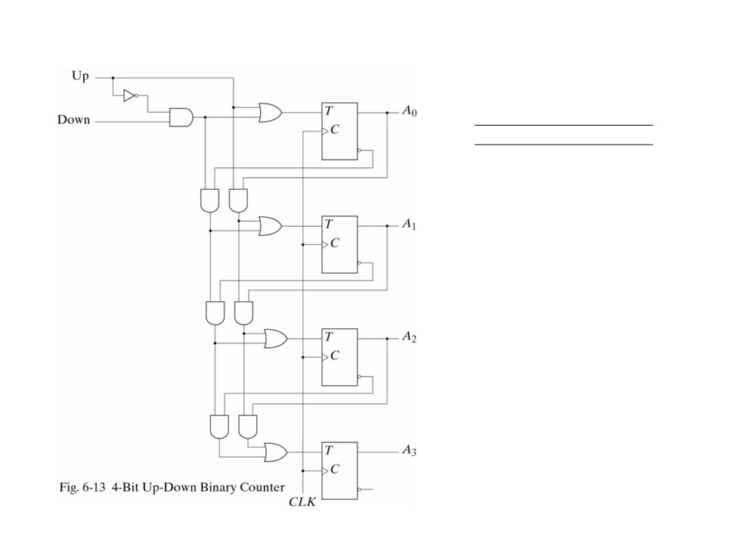
Up-Down Binary Counter
up down operation
1
x
count up
0
1
count down
0
0
no change
an up-down binary counter using T flip-flops
20

Slide 26
BCD Counter
21

Slide 27
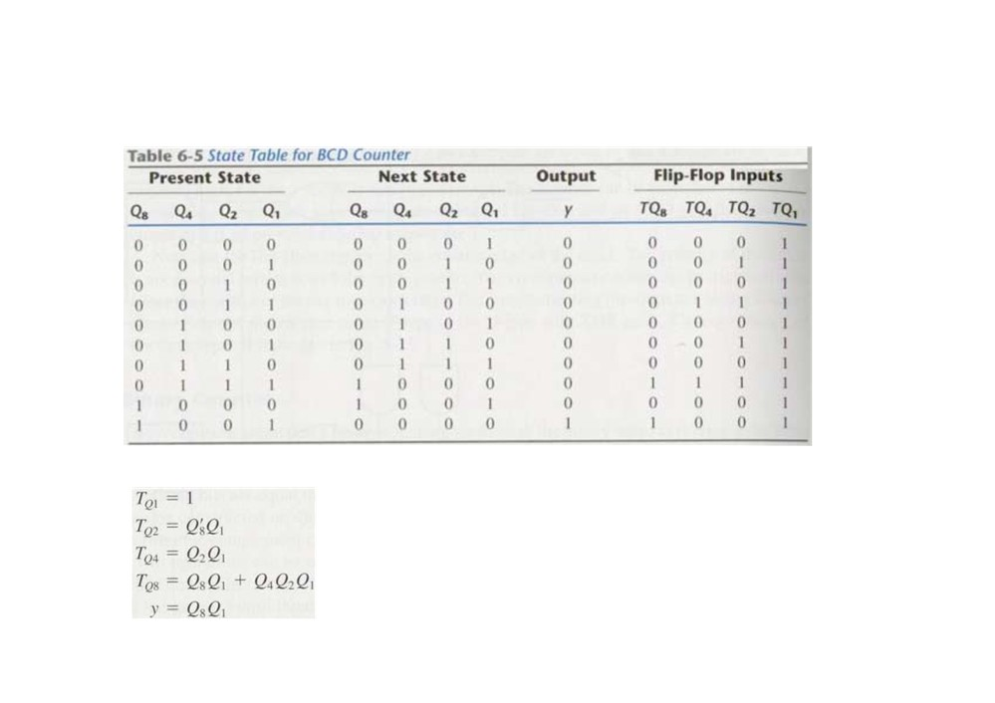
BCD Counter
count from 0000 to 1001 and back to 0000
minterms 10 to 15 are taken as don’t-care terms
4 T flip-flops, 5 AND gates, and 1 OR gate
21

Slide 28
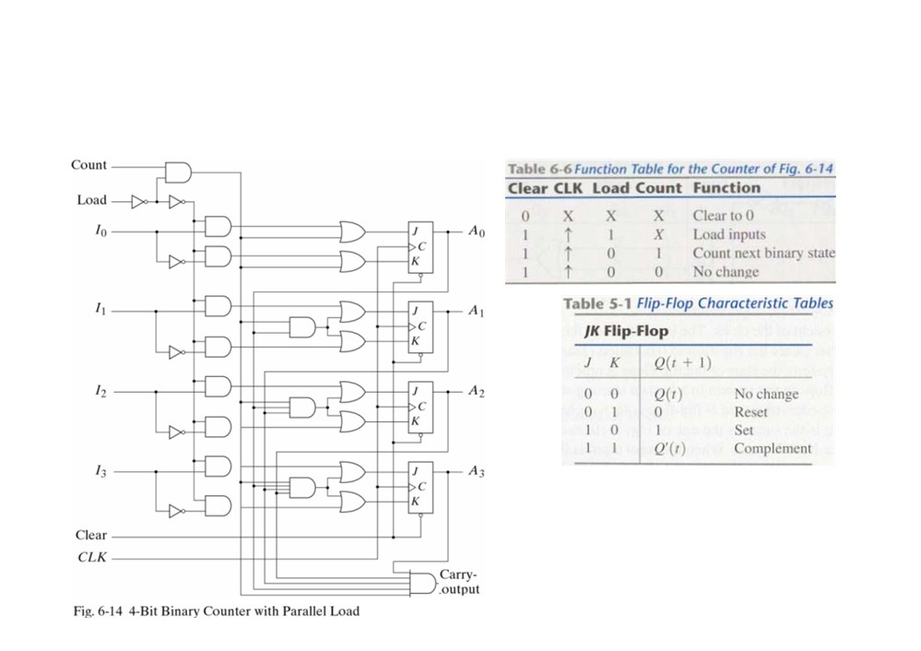
Binary Counter with Parallel Load
Load an initial binary number into the counter prior to the count operation
It can be used to generate
any desired count sequence
22

Slide 29
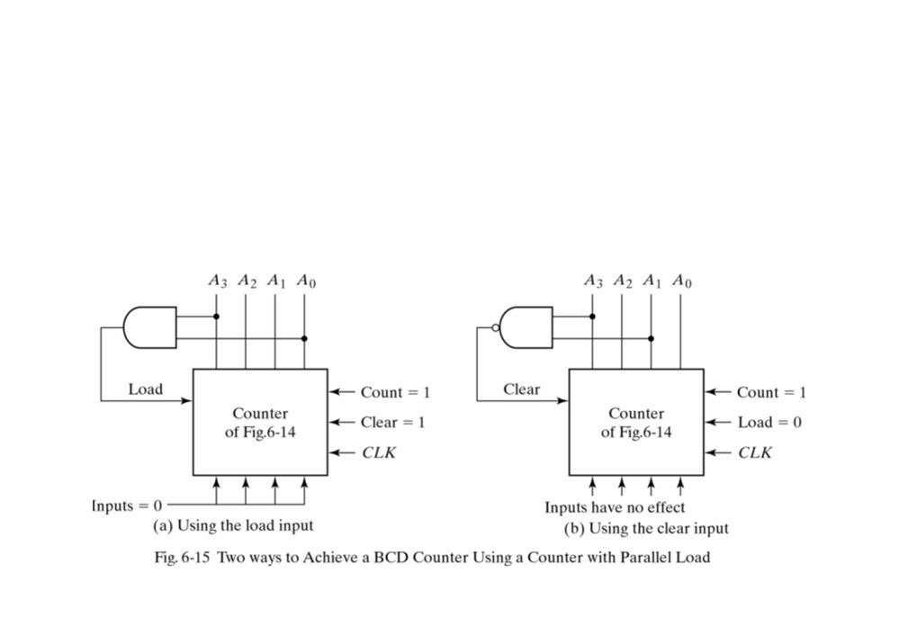
A BCD Counter using a Binary Counter with Parallel Load
The AND detects the
The NAND detects the
occurrence of state 1001 and
occurrence of state 1010 and
then the counter reloads 0
then the counter is cleared to 0
a counter with a parallel load can be used to generate any desired count sequence
unused states may be treated as don’t care conditions (investigate to determine the effect of the unused state (unused state에서 cycle 형성이 가능하기 때문이다.) or may be assigned specific next states
it is necessary to ensure that the circuit eventually goes into one of the valid states, so that it can resume normal operation.
23

Slide 30
6-5 Other Counters
• Divide-by-N counter (modulo-N counter): a counter that goes through a repeated sequence of N states
• Counters can be used to generate timing signals to control the sequence of operations in a digital system
• Counters can be constructed also by means of shift registers
• The sequence of counters may follow the binary count or may be any other arbitrary sequence
• non-binary counters
- Ring counter
- Johnson counter
24

Slide 31
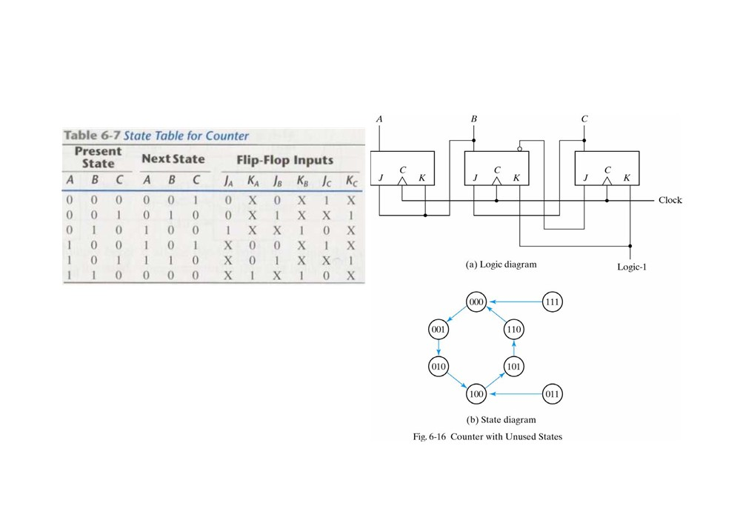
Counter with Unused States
•Outside interference may cause a circuit to enter one of the unused states
•Example:
two unused states: 011 and 111 Simplified equations:
JA=B KA=B
JB=C KB=1 JC=B’ KC=1
We need to analyze the circuit to determine the effects of unused states!
Self correcting counter: if it happens to be in an unused state, it eventually
reaches the normal counter sequence after one or more clock pulses
25

Slide 32
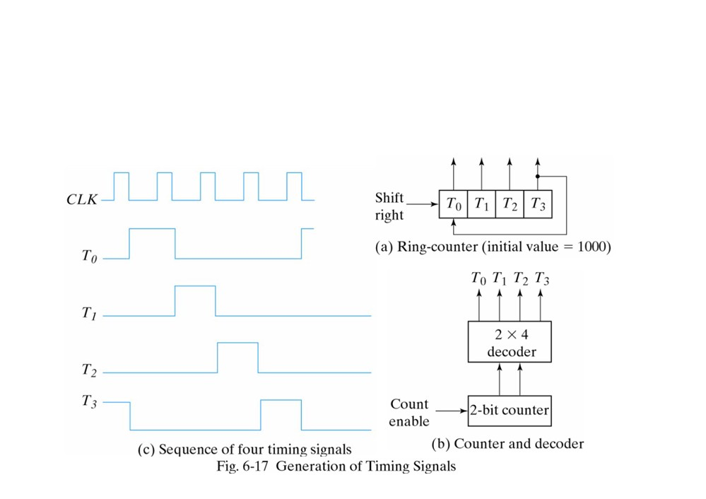
Ring Counter
• ring counter: a circuit shift register with only one flip-flop being set an any particular time, all others are cleared. The single bit is shifted from one flip- flop to the next to produce the sequence of timing signals
• Two approaches: (a) ring-counter (b) counter and decoder
• k-bit ring counter: k flip-flops to provide k distinguishable states
26

Slide 33
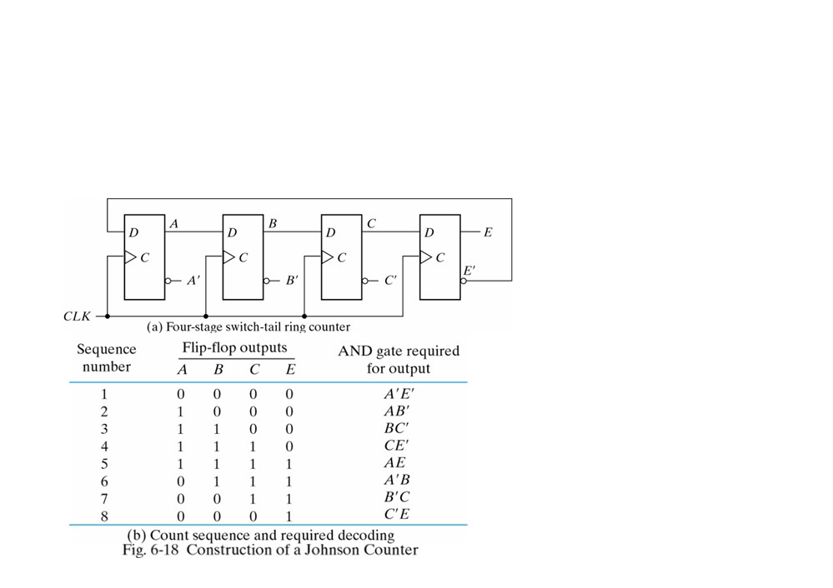
Johnson Counter
switch-tail ring counter: a circular shift register with the complement output of the last flip-flop connected to the input of the first flip-flop
- double the number of states for a ring counter (Figure 6-17a)
Johnson counter: a k-bit switch-tail counter with 2k decoding gates to provide outputs for 2k timing signals
Connecting Figure 6-18a
with 8 AND gates listed Figure 6-18b to complete the construction of the Johnson counter
• Disadvantage: it never finds its way to a valid state if it is at an unused state
-Correcting: DC = (A+C)B
• # of FF = ½ # of timing signals
• # of 2-input decoding gates = # of time signals
• the all 0’s state is decoded by taking the complement of
the two extreme flip-flop outputs
• the all 1’s state is decoded by taking the normal outputs of
the extreme flip-flop outputs
• all other states are decoded from an adjacent 1,0 or 0,1 pattern
in the sequence
27

Slide 34

Summary
Chapter 6 Registers and Counters
6-1 Registers
4-bit register, register with parallel load
6-2 Shift Registers
4-bit shift register, serial shift register, serial adder, second- form serial adder, universal shift register
6-3 Ripple Counters
4-bit binary ripple counter, count-down counter, BCD ripple counter, multi-decade BCD counter
6-4 Synchronous Counters
4-bit synchronous binary counter, count-down counter, up- down binary counter, BCD counter, binary counter with parallel load
6-5 Other Counters
ring counter, Johnson counter
28

